Slide 1
Bubble Trouble
A statistical analysis of the Bubble Sort.

Slide 2
The Guys Who Bring It To You
Jon Kroening
Nick Jones
Erik Weyers
Andy Schieber
Sean Porter

Slide 3
History and Background
Jon Kroening

Slide 4


The Bubble Sort
Popular algorithm used for sorting data
Iverson was the first to use name ‘bubble sort’ in 1962, even though used earlier
Unfortunately it is commonly used where the number of elements is too large

Slide 5
The Bubble Sort
Starts at one end of the array and make repeated scans through the list comparing successive pairs of elements
5 3 6 2 8 9 1
If the first element is larger than the second, called an inversion, then the values are swapped
3 5 6 2 8 9 1

Slide 6
The Bubble Sort
Each scan will push the maximum element to the top
3 5 6 2 8 9 1
3 5 6 2 8 9 1
3 5 2 6 8 9 1
3 5 2 6 8 9 1
3 5 2 6 8 9 1
3 5 2 6 8 1 9

Slide 7
The Bubble Sort
This is the “bubbling” effect that gives the bubble sort its name
This process is continued until the list is sorted
The more inversions in the list, the longer it takes to sort

Slide 8
3 5 2 6 8 1 9
3 5 2 6 8 1 9
3 2 5 6 8 1 9
3 2 5 6 8 1 9
3 2 5 6 8 1 9
3 2 5 6 1 8 9
2 3 5 6 1 8 9
2 3 5 6 1 8 9
2 3 5 6 1 8 9
2 3 5 1 6 8 9
2 3 5 1 6 8 9
2 3 5 1 6 8 9
2 3 1 5 6 8 9
2 3 1 5 6 8 9
2 1 3 5 6 8 9
1 2 3 5 6 8 9

Slide 9
Bubble Sort Algorithm
template <typename R>
void bubbleSort(vector<R>& v)
{
int pass, length;
R temp;
for( length = 0; length < v.size()-1; length++)
{
for(pass = 0; pass < v.size()-1; pass ++)
{
if(v[pass] > v[pass +1])
{
temp = v[pass];
v[pass] = v[pass + 1];
v[pass + 1] = temp;
}
}
}
}

Slide 10
Best and Worst Case Scenarios
Nick Jones

Slide 11
Best Case of the Bubble Sort
Let X: number of interchanges (discrete).
Consider list of n elements already sorted x₁ < x₂ < x₃ < … < x_{n}

Slide 12
Best Case (cont.)
Only have to run through the list once since it is already in order, thus giving you n-1 comparisons and X = 0.
Therefore, the time complexity of the best case scenario is O(n).

Slide 13
Worst Case of the Bubble Sort
Let X: number of interchanges (discrete).
Consider list of n elements in descending order x₁ > x₂ > x₃ > … > x_{n}.

Slide 14
Worst Case (cont.)
# of comparisons = # of interchanges for each pass.
X = (n-1) + (n-2) + (n-3) + … + 2 + 1
This is an arithmetic series.

Slide 15
Worst Case (cont.)
(n-1) + (n-2) + … + 2 + 1 = n(n-1)/2
So X = n(n-1)/2.
Therefore, the time complexity of the worst case scenario is O(n²).

Slide 16
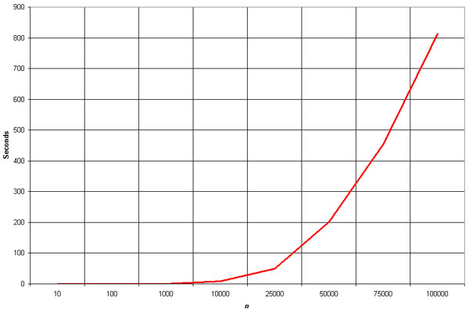
Time Complexity Model of the Worst Case
Time in seconds
# elements

Slide 17
Average Case
Nick Jones, Andy Schieber & Erik Weyers

Slide 18
Random Variables
A random variable is called discrete if its range is finite or countably infinite.
Bernoulli Random Variable – type of discrete random variable with a probability mass function p(x) = P{X = x}

Slide 19
Bernoulli Random Variable
X is a Bernoulli Random Variable with probability p if p_{x}(x) = p^{x}(1-p)^{1-x}, x = {0,1}.
Other notes: E[X] = p

Slide 20
Expected Value
The expected value of a discrete random variable is

Slide 21
Sums of Random Variables
If are random variables then
i.e. expectation is linear

Slide 22
Analytic Estimates for Bubble Sort
I = number of inversions
X = number of interchanges
Every inversion needs to be interchanged in order to sort the list, therefore X must be at least I,
E[X] = The average number of inversions

Slide 23
and

Slide 24
The probability that i, j are inverted is .5
I is a Bernoulli random variable,
therefore
there are
terms in the above sum

Slide 25
Since p(I) = .5 and there are
terms in the above sum
then

Slide 26
So
The average case is equivalent to the worst case

Slide 27
Simulation Results
Jon Kroening, Sean Porter, and Erik Weyers

Slide 28
int MAX = 99;
int Random[MAX];
int temp, flag;
for(int i = 0; i<100; i++)
{
flag = 1; // Random Number
temp = 1+(int) (100.0*rand()/(RAND_MAX+1.0)); //obtained
for(int check = 0; check <= i; check++){
if(Random[check] == temp) //Checks if number is
flag = 0; // already obtained
}
if(flag == 0) //if number is already obtained
i--; //then it will reloop to find new one
else{
Random[i] = temp; //Otherwise enters number
cout << Random[i] << endl; //in array and displays
}
}

Slide 29
Simulation Results

Slide 30
Worst Case:

Slide 31
Closing Comments
The Bubble sort is not efficient, there are other sorting algorithms that are much faster

Slide 32
A Final Note
Thank you Dr. Deckleman for making this all possible

Slide 33
References
“Probability Models for Computer Science” by Sheldon Ross, Academic Press 2002

